Slide 1
SkillSwap

Slide 2

Problem
The average online course costs thousands
80% of learners never finish online courses
Skills exist everywhere — but connections don’t

Slide 3

So why is learning still broken?
One-way platforms dominate.
YouTube, Udemy, Coursera deliver content, but interaction is limited.
Untapped teaching potential.
Everyone has a skill to share, yet no platform
allows easy two-way learning.

Slide 4

Solution
Break the cost barrier
Make learning accessible without expensive subscriptions or tuition.
Encourage completion
Keep learners engaged and motivated so fewer drop out.
Create two-way interaction
Move beyond passive content—enable learners and teachers to connect directly.
Unlock hidden teaching potential
Give everyone a way to share their skills with others.

Slide 5
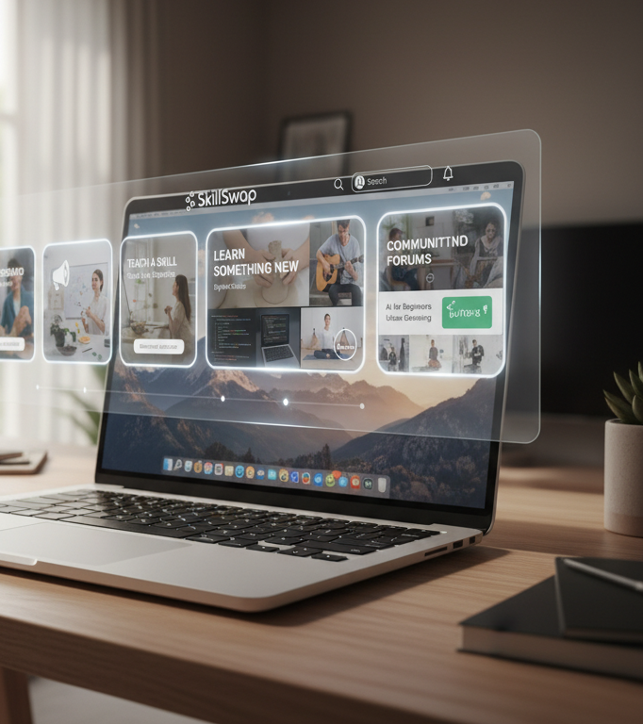

Knowledge for Knowledge

Slide 6

Product overview
Two-way skill exchange
Learn and teach at the same time.
Accessible & affordable
Free core platform; optional premium features.
Global collaboration
AI matches learners & teachers; real-time translation & time zone sync.
Community-driven
Ratings, reviews, and digital tokens reward high-quality teaching.

Slide 7
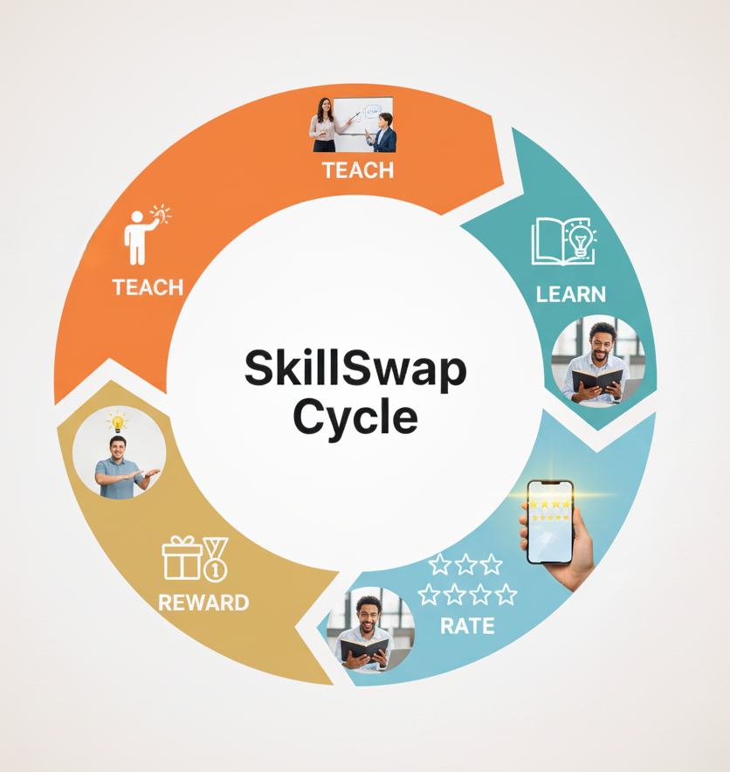
How SkillSwap Works
Sign Up → Create Profile
List & Match → Skills & AI Matching
Connect → Chat / Video Sessions
Exchange & Reward → Rate & Digital Tokens

Slide 8
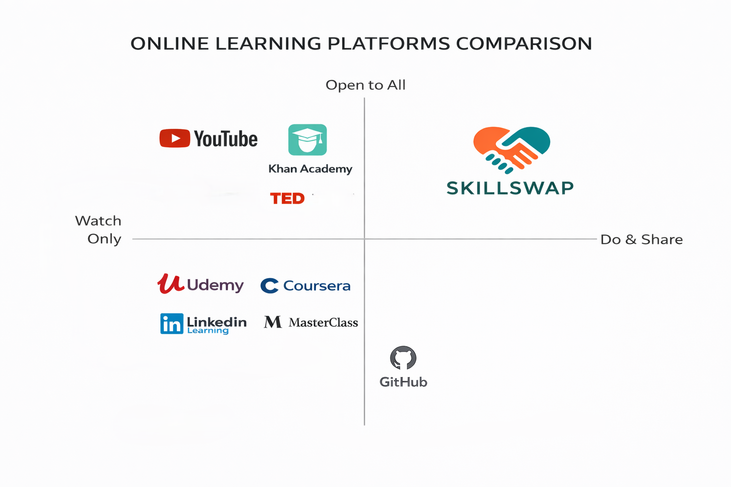
Pay to Play

Slide 9

EdTech Market & SkillSwap Opportunity
Global EdTech Market (2026): $404 Bn → $605 B by 2030
Market Segments:
Online Courses → $150 Bn
Free Content Platforms → $80 Bn
Corporate Upskilling → $120 Bn
Traditional EdTech → $54 Bn
Untapped Niche: Peer-to-Peer Skills $10–15B → SkillSwap
Target Users: Students, Freelancers, Early-Career Professionals, Self-Learners
Market Gap: Affordable, interactive, global learning → SkillSwap fills this gap

Slide 10
How SkillSwap Makes Money
Premium Memberships → Ad-free, priority features
Certificates / Skill Verification → Optional badges
Featured Profiles & Tokens → Voluntary support
Core Idea: Free for all, monetized optionally

Slide 11
Financials
Revenue Source | Year 1 | Year 2 | Year 3
Premium Memberships | 500 | 1,500 | 5000+
Skill Verification / Certificates | 50 | 200 | 500
Featured Profiles / Ads | 1000 | 3000 | 10000+
Total Revenue (₨) | 235,000 | 835,000 | 3,200,000

Slide 12
Members
Farhan
Ibad
Sharjeel
Taha

Slide 13

Thank you

